Slide 1

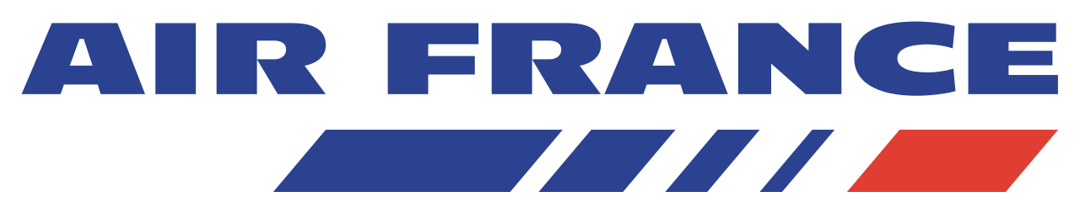
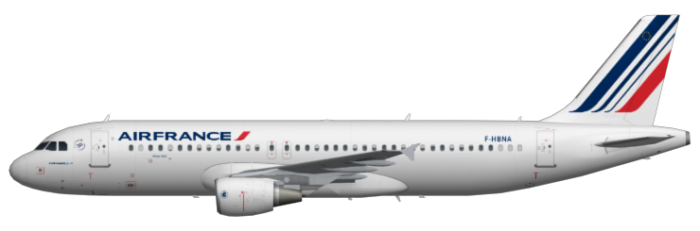
Analysis & Recommendations for Air France’s Future Campaign Funding
3rd Dec 2019
Data Science in R, MsBa-5, Team 3:
Neil Parekh,
German Perdomo,
Yi Yuan,
Oliver Baseley,
Jorge Betancourt,
Salewa Oyagbola
Notes:
Salewa

Slide 2
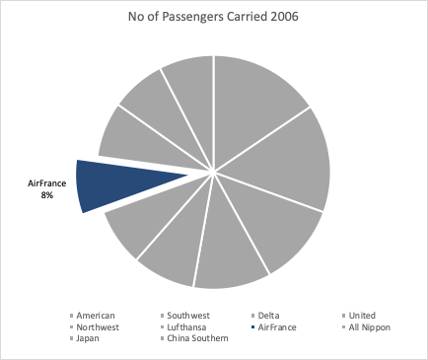
Analysis & Recommendations - Context
Air France currently has a global market share of 8%
Search Engines drive sales
Cost-per-click is increasing
Significant data cleaning was required
Notes:
Salewa

Slide 3
Executive Summary
Challenge
Determining the most effective strategies (uniform or tailored) to boost Air France market share
Determining the most effective SEM channels that will yield the highest profit
Insights
Important performance indicators are ROA, conversion rates and click through rates
Branded keywords V/S Unbranded keywords
Recommendations
Invest more in Yahoo
Use Kayak as an alternative platform to gain higher revenues
Utilize a tailored SEM strategy
Source: Air France Internet Marketing, Kellogg School of Management
Notes:
Salewa
Not enough data to effectively compare Kayak to MSN, YAHOO, GOOGLE... because Kayak not integrated with DoubleClick
Kayak has a much higher ROA than other search engines. click-through-rate: 8%
Industry average: 0.8%

Slide 4
SEM KPIs & Data Cleaning
Search Engine Marketing KPIs
ROA ($) = Amount/Spend
Transaction Conversion %
Click Through %
Data Cleaning
Branded keywords bring in more revenue
Unbranded keywords bring in larger Transaction Conversion %
The last keyword clicked is credited for sale
Time frames are unclear and would have been helpful to gain deeper insights
Source: Air France Internet Marketing, Kellogg School of Management
Notes:
Salewa
Airline paid fee to aggregator (expedia, priceline…) mostly under unbranded keyword searches

Slide 5
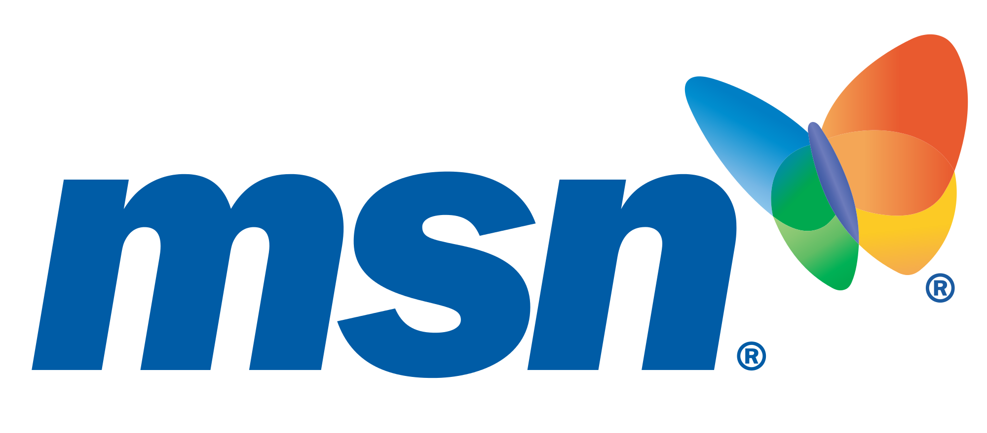

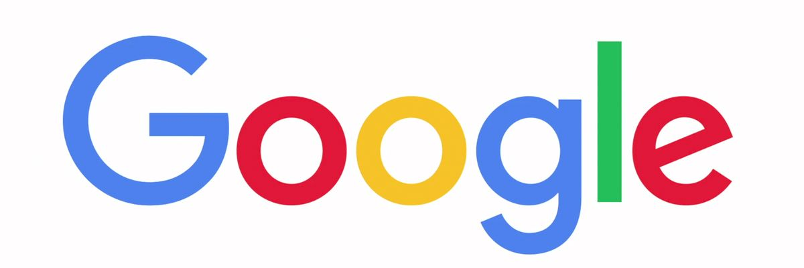
Most Effective Channel
Insights
Based on the ROA´S
Great Opportunity With Kayak
Yahoo-US and MSN has the highest ROA as compared to other platforms (DoubleClick)
Yahoo reaches 160 million customer through the network
Google Ideal for Volume and cheap
Based on Probability of Booking and Financials
Conversion rate is higher on MSN and Yahoo
Cost per acquisition is also lower as compared to Google
Source: Air France Internet Marketing, Kellogg School of Management
Notes:
German

Slide 6
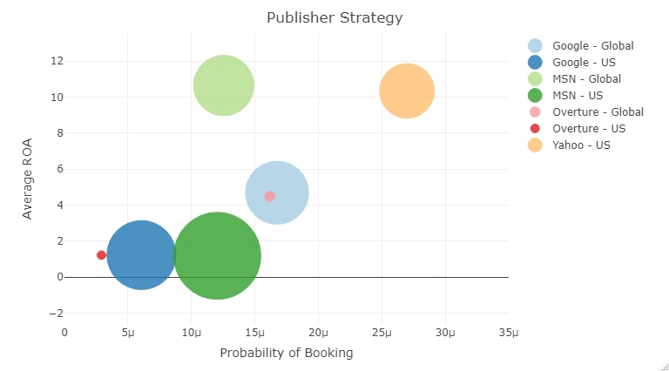
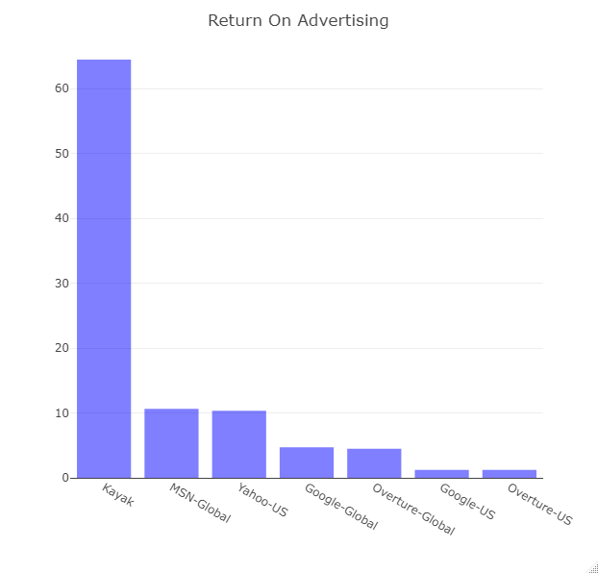
Most Effective Channel
Comparison Between Different SEM
(Bubble Size = Cost per Click)
64.5
10.65
10.34
1.25%
2.64%
10.65
10.34
Source: Air France Internet Marketing, Kellogg School of Management
Notes:
German

Slide 7
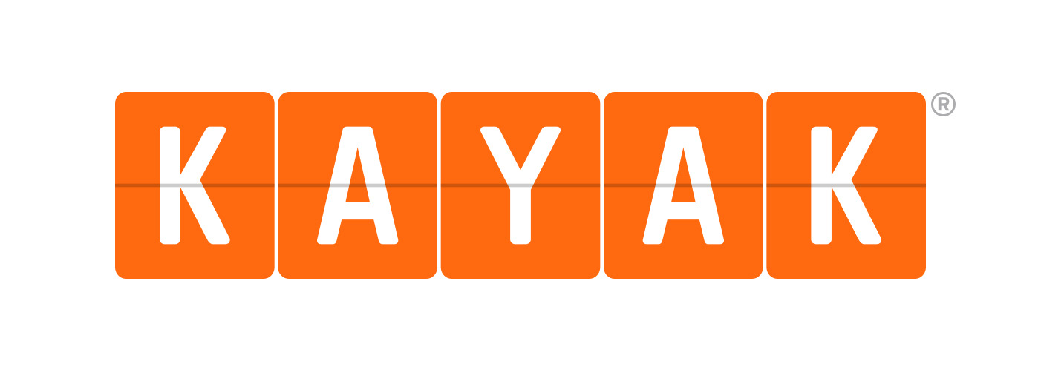
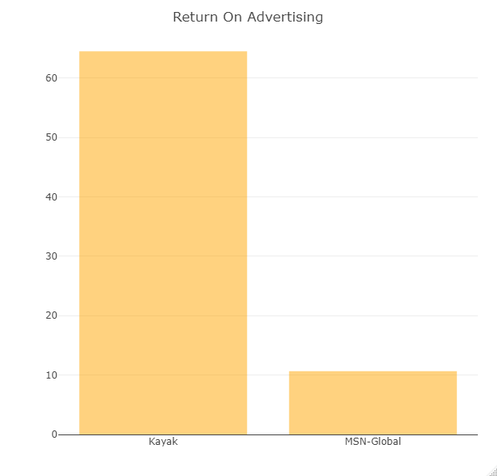
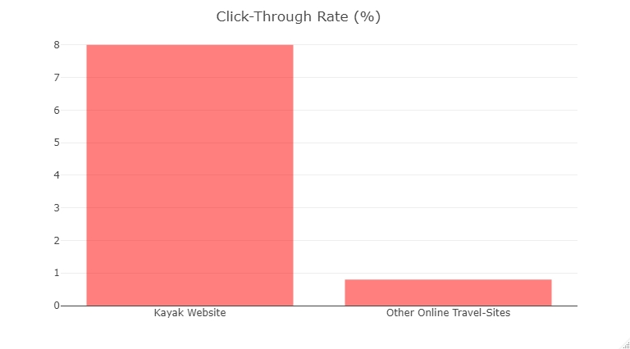
Most Effective Channel
Recommendation = Bet on Kayak
ROA is 5X MSN & Yahoo
Outstanding Click-Through Rate
How?
Kayak services are optimized
and low cost
64.5
8 %
10.65
0.8 %
Source: Air France Internet Marketing, Kellogg School of Management
Notes:
German

Slide 8
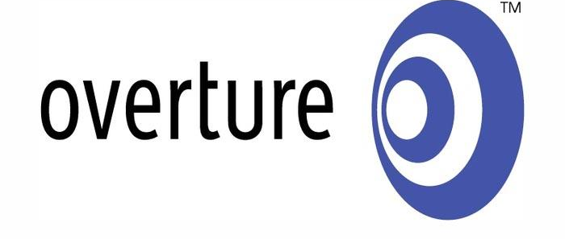
SEM Strategy per Channel
Best Match Type & Bid Strategy
SEM Market |  | US | Global | US | Global | US | Global | US
SEM Strategy Choices | Match Type | Broad | Exact | Standard | Standard |  |  | Advanced
 | Bid Position | 5-10 |  |  | 2-5 | 2-5 | 2-5
Source: Air France Internet Marketing, Kellogg School of Management
Notes:
Oli

Slide 9
SEM Strategy per Channel
Best Match Type & Bid Strategy
SEM Market |  | US | Global | US | Global | US | Global | US
SEM Strategy Choices | Match Type | Broad | Exact | Standard | Standard |  |  | Advanced
 | Bid Position | 5-10 |  |  | 2-5 | 2-5 | 2-5
SEM Market |  | US | Global | US | Global | US | Global | US
SEM Strategy Choices | Match Type | Broad | Exact | Standard | Standard |  |  | Advanced
 | Bid Position | 5-10 |  |  | 2-5 | 2-5 | 2-5
Source: Air France Internet Marketing, Kellogg School of Management
Notes:
Oli

Slide 10
Tailored vs Uniform SEM Strategy
Conclusion = Tailored
Goal: Right Ad at the Right Time for the Right Person
Each platform is architectured differently and continuingly changing
A Uniform Strategy would deliver a lower ROA, Transaction Conversion % & Click Through %
Tailored vs Uniform Statistical Analysis
8.3x average improvement in ROA by tailoring the Match Type
38.5x average improvement in ROA by tailoring the Bid Strategy
Notes:
Oli

Slide 11
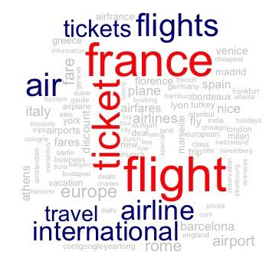
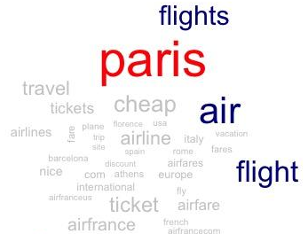
SEM Keyword Strategy
Best across all channels
Keywords Insights
Branded keywords bring in more revenue
Unbranded keywords bring in larger Transaction Conversion %
Source: Air France Internet Marketing, Kellogg School of Management
Notes:
Jorge

Slide 12
SEM Keyword Strategy
Best per channel
SEM Market |  | US 134 obs | Global 89 obs | US 48 obs | Global 45 obs | US 9 obs | Global 10 obs | US 33 obs
SEM Keyword Choices |  | France Paris Flights | Paris France Flights | Flight Ticket Air | France Air Paris | Air France Airfrance | Air France Paris | Paris France International
Source: Air France Internet Marketing, Kellogg School of Management
Source: Air France Internet Marketing, Kellogg School of Management
Notes:
Jorge

Slide 13
Summary of Findings
Yahoo yields good conversion rate despite of not having any bids on the platform
Largest share of the budget went to Google Adwords
Overture carries less conversion rate
MSN US has the highest cost per click
Return on Advertising is lower on Google as costs are higher (Volume)
ROA on Kayak is 5x more than the best performing channel
Source: Air France Internet Marketing, Kellogg School of Management
Notes:
Jorge

Slide 14
Final Recommendations
Air France can optimise their expenses and reach out to more customers:
Invest more in Yahoo and MSN, less competition on those platforms
Spend on pay per click or SPONSORED ADs on Google, and focus on demographics and geo targeting on Yahoo and MSN
Allocate a higher amount from the budget to Kayak, which has the best metrics
Source: Air France Internet Marketing, Kellogg School of Management
Notes:
Jorge
Merge with different affiliations /partners in order to increase exposure and revenues

Slide 15
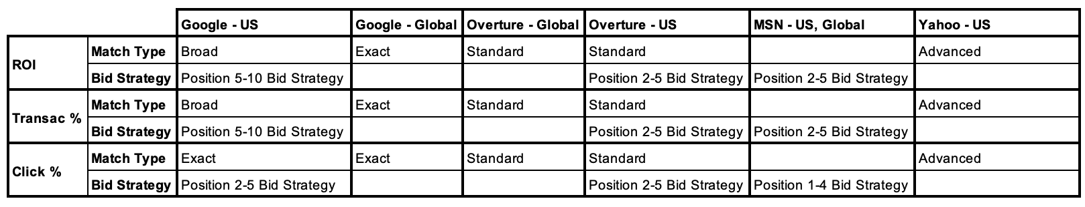
Appendix : Best Match/Bid Strategy per Channel
What caused the successes
Source: Air France Internet Marketing, Kellogg School of Management

Slide 16
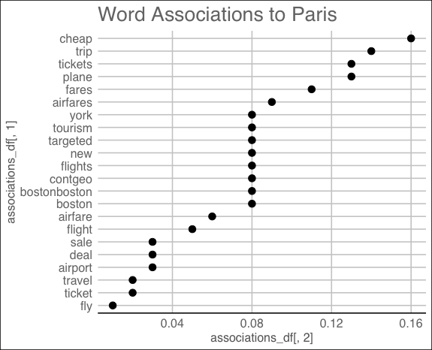
Appendix : Word Associations
Keywords Analysis
Source: Air France Internet Marketing, Kellogg School of Management

Slide 17
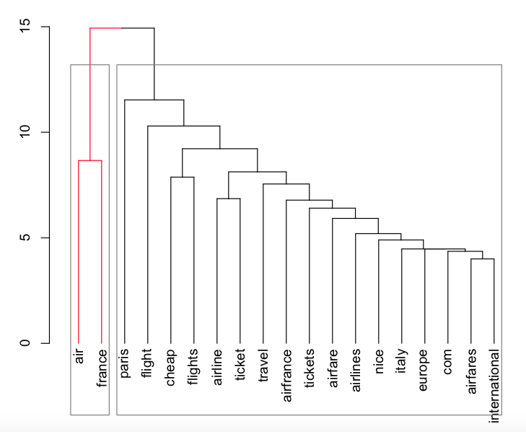
Appendix : Word Clustering
Keywords Analysis
Word Clustering Insights
The most associated words with Air France is Paris
Source: Air France Internet Marketing, Kellogg School of Management

Slide 18
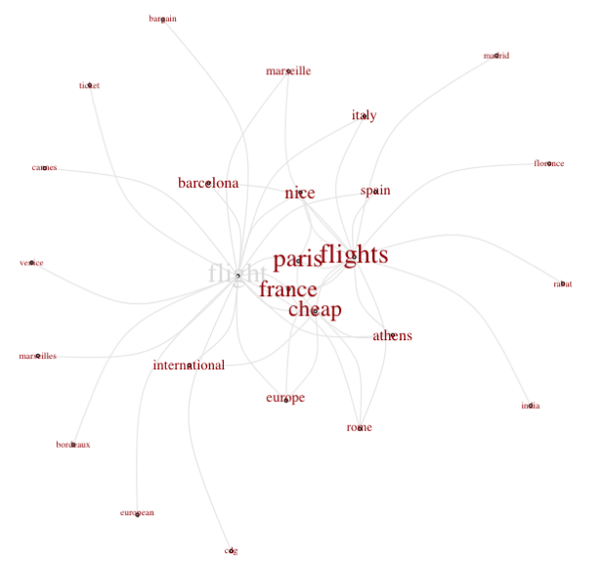
Appendix : Word Network
Airfrance Flight word association
Word Network Insights
The association is strong with destinations such as Italy, Spain, Barcelona.
Paris, France and Cheap are the most associated words
International destinations show a week association
Source: Air France Internet Marketing, Kellogg School of Management

